Slide 1
GUIDE TO YACC AND LEX

Slide 2
Introduction
Yacc: a parser generator
  Describing the input to a computer program.
  Take action when a rule matched.
Lex: a lexical analyser generator
  Recognise regular expression
  Take action when one word matched

Slide 3
Parsing. better choice
parsing tools accept the format like :
LIST '=' VALUE {
$$ = $3; /*$$ is result, $3 is the value of "VALUE"*/
}
YACC and LEX do this work well!

Slide 4
Yacc Overview
Purpose: automatically write a parser program for a grammar written in BNF.
Usage: you write a yacc source file containing rules that look like BNF.
Yacc creates a C program that parses according to the rules
term : term '*' factor { $$ = $1 * $3; }
| term '/' factor { $$ = $1 / $3; }
| factor { $$ = $1; }
;
factor : ID { $$ = valueof($1); }
| NUMBER { $$ = $1; }
;

Slide 5
Yacc Overview(2)
myparser.y
BNF rules and actions for your grammar.
The programmer puts BNF rules and token rules for the parser he wants in a bison source file myparser.y
run yacc to create a C program (*.tab.c) containing a parser function.
The programmer must also supply a tokenizer named yylex( )
> yacc myparser.y
myparser.tab.c
parser source code
yylex.c
tokenizer function in C
> gcc -o myprog myparser.tab.c yylex.c
myprog
executable program

Slide 6
Yacc Overview(3)
In operation:
your main program calls yyparse( ).
yyparse( ) calls yylex() when it wants a token.
yylex returns the type of the token.
yylex puts the value of the token in a global variable named yylval
yyparse() call action when one rule matched
input file to be parsed.
yylex( )
tokenizer returns the type of the next token
yylval
yyparse( )
parser created by bison
call action when rule matched

Slide 7
Yacc source file
The file has 3 sections, separated by "%%" lines.
/* declarations go here */
%%
/* grammar rules go here */
%%
/* additional C code goes here */
Note: format for "yacc" is the same as for bison.

Slide 8
Yacc source file example
Structure of Bison or Yacc input:
%{
/* C declarations and #DEFINE statements go here */
#include <stdio.h>
#define YYSTYPE double
%}
/* Bison/Yacc declarations go here */
%token NUMBER /* define token type NUMBER */
%%
/* grammar rules go here */
%%
/* additional C code goes here */
Provide by yylex(), which
abstracts detail to a token

Slide 9
Yacc source file example(2)
%% /* Bison grammar rules */
input : /* empty production to allow an empty input */
| input line
;
line : term '\n' { printf("Result is %f\n", $1); }
;
term : term '*' factor { $$ = $1 * $3; }
| term '/' factor { $$ = $1 / $3; }
| factor { $$ = $1; }
;
factor : NUMBER { $$ = $1; }
;

Slide 10
Yacc source file example(3)
$1, $2, ... represent the actual values of tokens or non-terminals (rules) that match the production.
$$ is the result.
rule
pattern to match
action
term : term '*' factor { $$ = $1 * $3; }
| term '/' factor { $$ = $1 / $3; }
| factor { $$ = $1; }
;
Example:
if the input matches term / factor then set the result ($$) equal to the value of term divided factor ($1 / $3).

Slide 11
Introduction to Lex
/* Bison/Yacc declarations go here */
%token NUMBER /* define token type NUMBER */
factor : NUMBER { $$ = $1; }
;
NUMBER,is given by Lex.
Yacc calls yylex() to get the token and vale.

Slide 12
Introduction to Lex. cont.
Lex is a program that automatically creates a scanner in C, using rules for tokens as regular expressions.
Format of the input file is like Yacc.
%{
/* C definitions for scanner */
%}
flex definitions
%%
rules
%%
user code (extra C code)

Slide 13
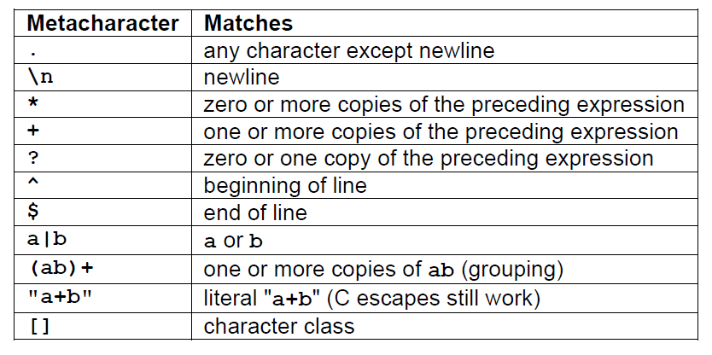
Regular Expression example
Regular Expression Strings in L(R)
digit = [0-9] “0” “1” “2” “3” …
posint = digit+ “8” “412” …
int = -? posint “-42” “1024” …
[a-zA-Z_][a-zA-Z0-9_]* C identifiers

Slide 14
Lex example
Read input and describes each token read.
/* flex definitions */
DIGIT [0-9]
%%
[ \t\n]+ {}
-?{DIGIT}+ { printf("Number: %s\n", yytext);
yylval=atoi(yytext); return NUMBER; }
\n printf("End of line\n"); return 0;
%%
/* all code is copied to the generated .c file*/

Slide 15
Example explanation
/* flex definitions */
DIGIT [0-9]
%%
[ \t\n]+ {}
-?{DIGIT}+ { printf("Number: %s\n", yytext);
yylval=atoi(yytext); return NUMBER; }
\n printf("End of line\n"); return 0;
%%
/* all code is copied to the generated .c file*/
Yacc get the value
Yacc get the token

Slide 16
Further studying
Regular expression
Debug

Slide 17
Review
mygrammer.y
BNF rules for your grammar.
mylex.fl
Regular expressions that match and return tokens
> yacc –d mygrammar.y
> lex mylex.fl
mygrammar.tab.c
yy.tab.h
lex.yy,c
tokenizer function in C
> gcc -o myprog mygrammar.tab.c lex.yy.c
myprog
executable program

Slide 18
Thanks

